Slide 1
UK Weather Quiz!
Test your skills about UK weather!

Slide 2
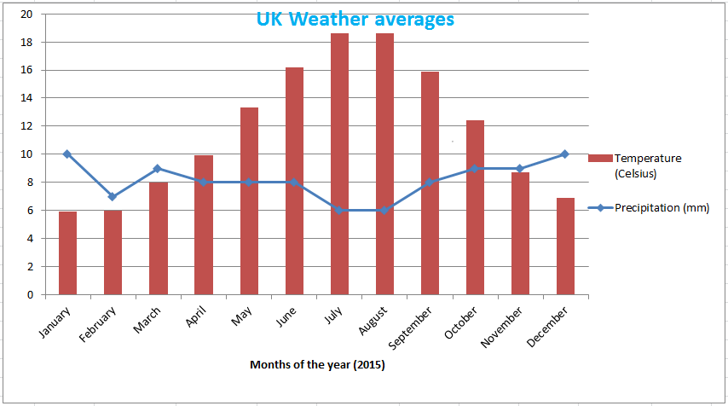
1. What is the Hottest Month In England ?
A: June
B: July
C: August
D: C &B
Answer
D

Slide 3
2. What is the coldest month in England ?
A:January
B:Febuary
C:A &B
D:December
Answer
C

Slide 4
3. Which month has the highest Precipitation ?
A:January
B:Febuary
C:A & D
D:December
Answer
C

Slide 5
4. Which month has the lowest Precipitation ?
A:B & C
B:July
C:August
D:June
Answer
A

Slide 6
5. Which month has the temperature of 8 ?
A:March
B:April
C:May
Answer
D:All of them
A

Slide 7
Thankyou for doing the quiz

